Slide 1
Movie Recommendation System
Popcorn Predictors - Team number 2
(Ethan Iwama, Meghna Sharma, Eren Kaval, Cherron Griffith, Santiago Bernheim, Patrick Wang)
04.02.25

Slide 2
About…
Goal: Recommend movies using user preferences and movie metadata
Dataset: TMDB 5000 Movie Dataset
Techniques: Demographic Filtering, Content-Based Filtering, Collaborative Filtering
Tools: Data cleaning (pandas & numpy) JSON parsing for structured metadata
Visualization (Seaborn & Matplotlib)
Notes:
Meghna Double Column with Big Title → This I think should be our introduction to the presentation, say why we’re doing this

Slide 3
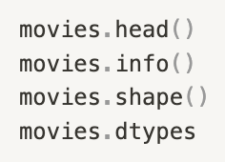
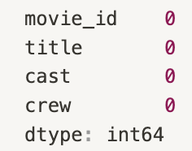
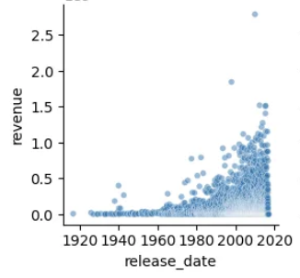
Data Cleaning
T H E D A T A
0 1 .
Corrected column data types and extracted relevant values from columns containing lists of Python dictionaries
0 2 .
Handled missing values by ensuring they were properly represented according to the column data type, without discarding too much data
Exploratory Data Analysis (EDA) was conducted on both datasets to identify missing values, correct column data types, and uncover significant relationships relevant to our project goal.
0 3 .
Refined the dataset to include only columns relevant to our project
0 4 .
Created visualizations to uncover significant relationships within the data
Notes:
Meghna List of things → The things we did to clean up data; just one slide, briefly state the issues encountered and how we fixed each one

Slide 4
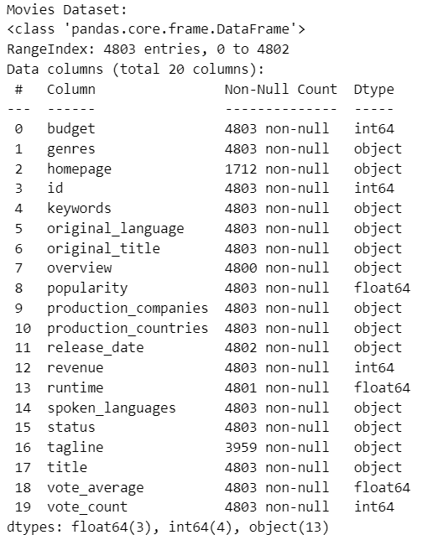
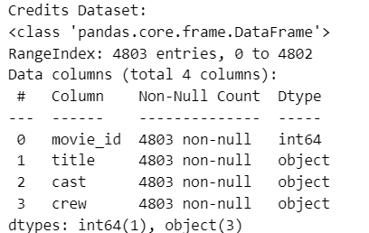
Column Selection
T H E D A T A
Chose columns most relevant to our project objectives:
Performance Metrics: popularity, vote_average, revenue, budget
Attributes: genres, language, runtime, title
People Involved: actors, directors
Notes:
Meghna Talk about why we think these columns are important

Slide 5
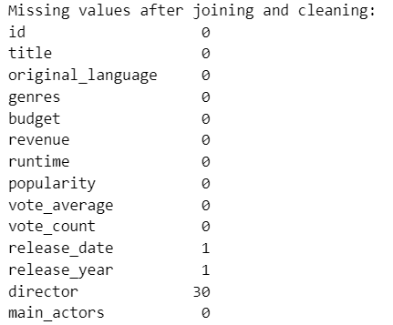
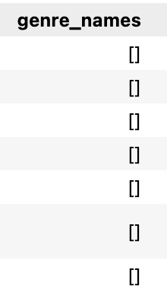
Handling Null Values
T H E D A T A
Obvious Null Values:
Hidden Null Example:
The compiler did not catch all null values, so additional steps were necessary
Adjusted null values to match the column data type
for columns containing lists, replaced empty lists with [Unknown]
set missing integer values to 0 and missing object (string) values to “Unknown”
Notes:
Santiago

Slide 6
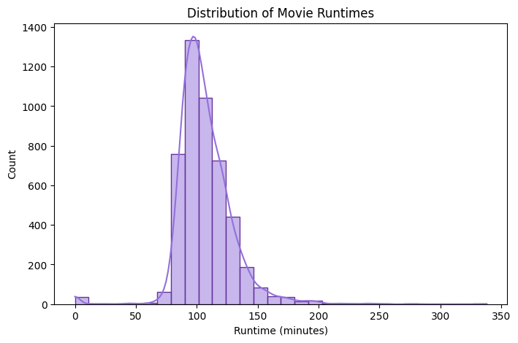
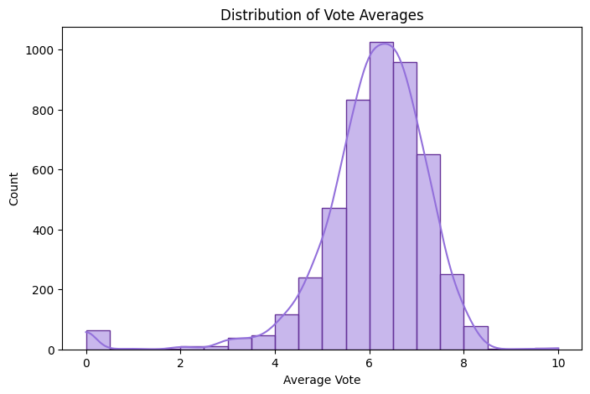
Key Observations: Value Distributions
T H E D A T A
Notes:
Santiago
Title and Graphs

Slide 7
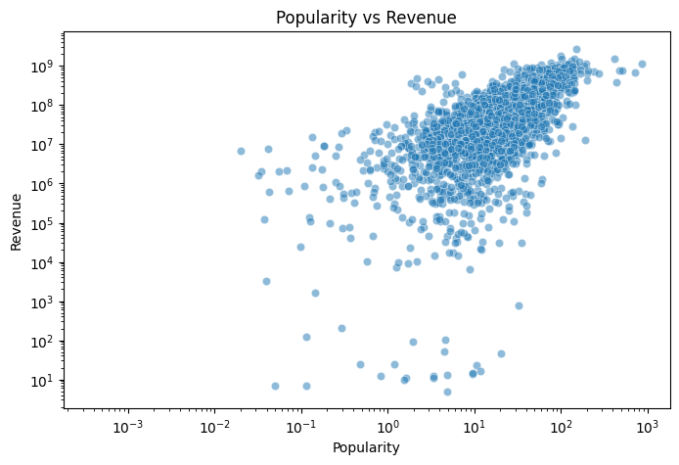
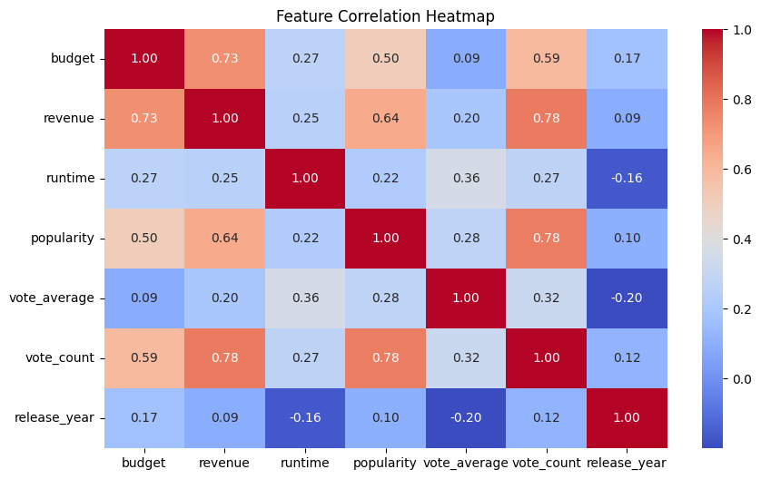
Key Observations: Column Correlations
T H E D A T A
Notes:
Santiago Talk about any positive/negative correlations (vote_average vs runtime; runtime vs release_year; vote_average vs release_year)

Slide 8
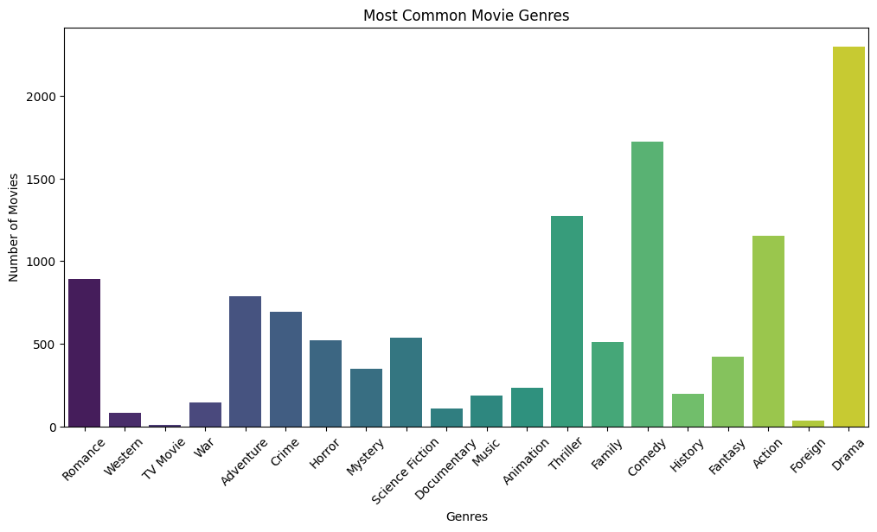
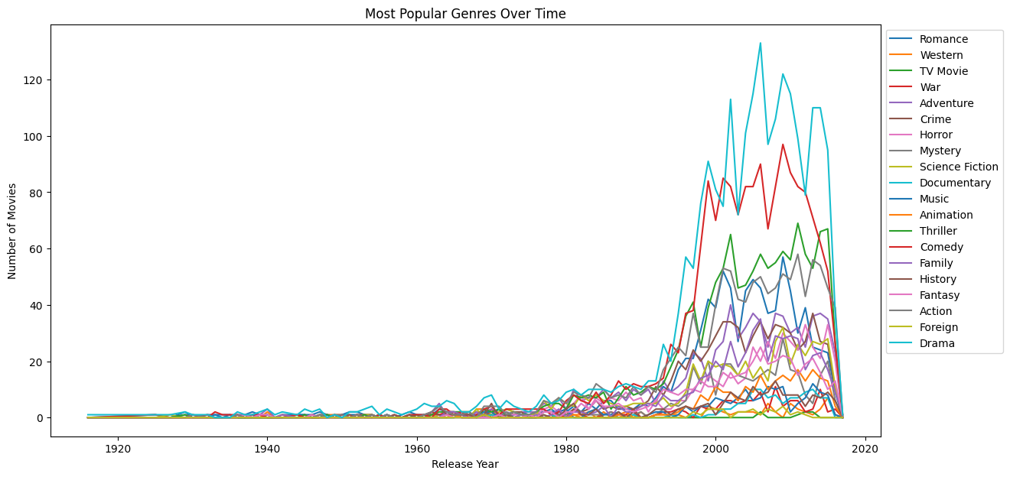
Key Observations: Genres
T H E D A T A
Notes:
Eren
Title and Graphs

Slide 9
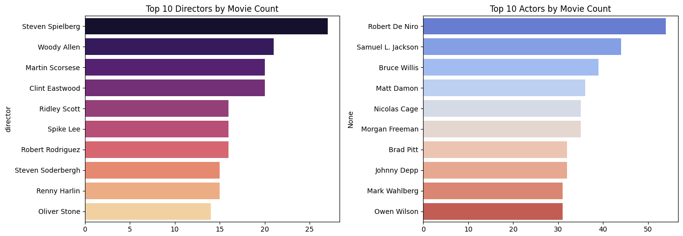
Key Observations: Actors & Directors
T H E D A T A
Notes:
Eren
Title and Graphs

Slide 10
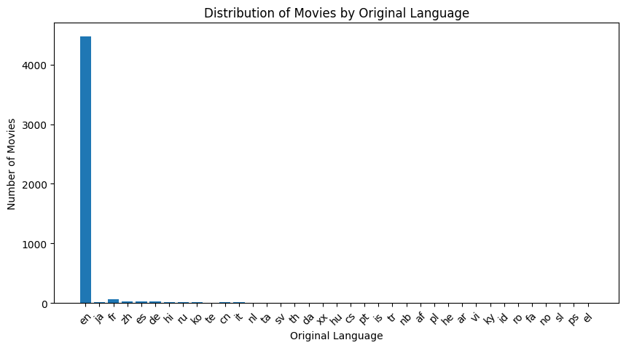
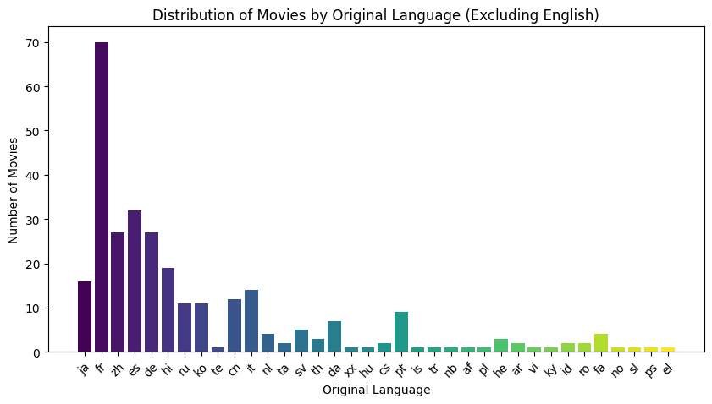
Key Observations: Languages
T H E D A T A
Notes:
Eren
Title and Graphs

Slide 11
Next Steps
F U T U R E P L A N
Baseline Model Development: Create weighted function metric (IMDB model could be used as reference) that would use vote averages and counts to recommend top rated movies
Content-Based Filtering: After determining top movies, use cleaned dataset used for analysis and train machine learning models using features to recommend movies that are similar
Based on initial impression a KNN method makes sense
Other considerations: Tree based methods
Model Evaluation and Visualization: Evaluate the models using various methods such as precision & recall
Precision: "Among movies recommended, how many are actually relevant to the user?"
Recall: "Of all the relevant movies, how many did we successfully recommend to the user?"
Notes:
Eren
Small title, text blurb, and room for graphs or code

Slide 12
Thankyou…
Popcorn Predictors - Team number 2
(Ethan Iwama, Meghna Sharma, Eren Kaval, Cherron Griffith, Santiago Bernheim, Patrick Wang)
04.02.25

